Slide 1

RL-based Graph2Seq for NQG
分享人：丁家杰
导师：周夏冰
2021.11.10

Slide 2
Catalog
1.background 2.architecture 3.Results

Slide 3
Background
1.QG 2.graph2seq 3.RL

Slide 4
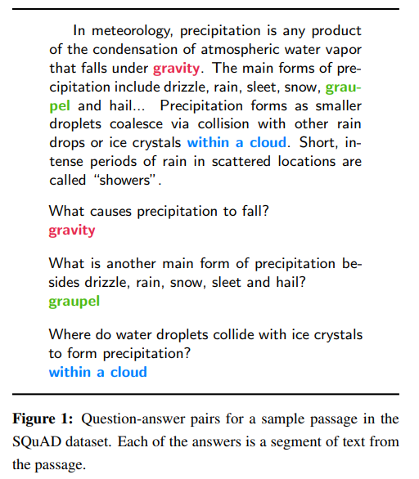
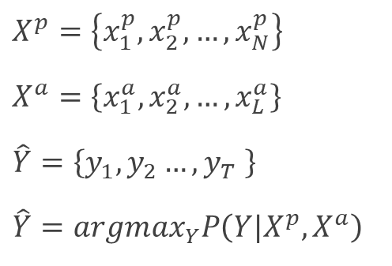
Question Generation
Background
$X^{p}=\left\{x_{1}^{p},x_{2}^{p},…,x_{N}^{p}\right\}$
$X^{a}=\left\{x_{1}^{a},x_{2}^{a},…,x_{L}^{a}\right\}$
$\hat{Y}=\left\{y_{1},y_{2}…,y_{T} \right\}$
$\hat{Y}={argmax}_{Y}P\left(Y|X^{p},X^{a}\right)$

Slide 5
GNN
Background
聚合与更新
(2,2,2,2)
B
(5,5,5,5)
(1,1,1,1)
E
邻居信息N=a*(2,2,2,2)+b*(3,3,3,3)+c*(4,4,4,4)
A
C
A的信息=σ(W(1,1,1,1)+α*N)，其中σ是激活函数
(3,3,3,3)
F
D
(4,4,4,4)
(6,6,6,6)
https://www.zhihu.com/zvideo/1319699425372344320

Slide 6
GNN
Background
Reduce function
聚合与更新
(2,2,2,2)
B
Message function
(5,5,5,5)
(1,1,1,1)
E
邻居信息N=a*(2,2,2,2)+b*(3,3,3,3)+c*(4,4,4,4)
A
C
A的信息=σ(W(1,1,1,1)+α*N)，其中σ是激活函数
(3,3,3,3)
F
D
Update function
(4,4,4,4)
(6,6,6,6)
https://www.zhihu.com/zvideo/1319699425372344320

Slide 7
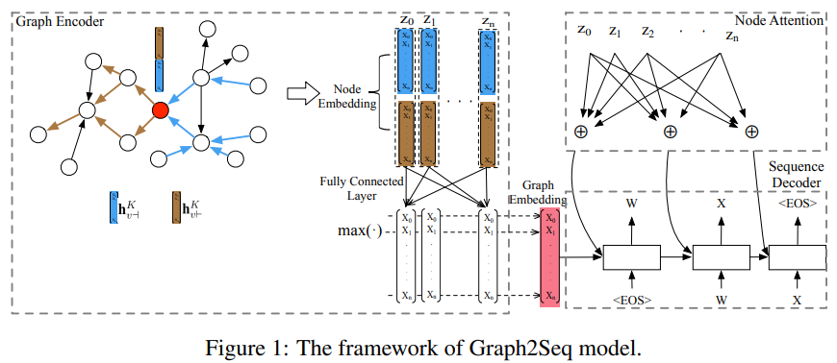
Grpah2Seq
Background
Graph Encoder
Seq Decoder
“Graph2Seq: Graph to Sequence Learning with Attention-based Neural Networks”

Slide 8
Reinforcement Learning
Background
Policy Gradient

Slide 9
Architecture
1.DAN 2.Graph Construction 3.Decoder
4.Hybrid evaluator

Slide 10
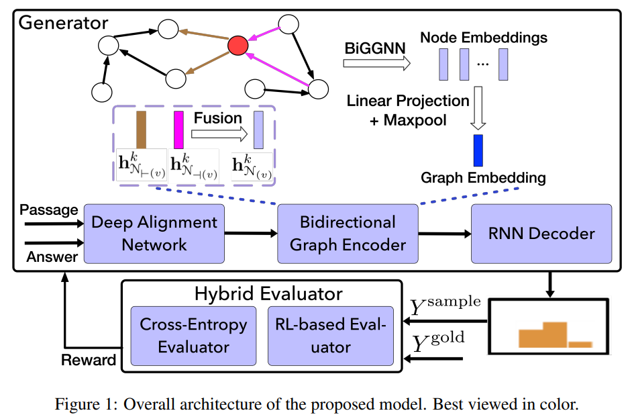
Graph2Seq
Architecture

Slide 11
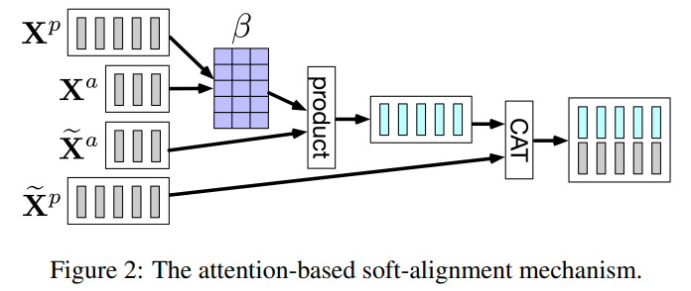


Deep Alignment Network
Architecture
Word-Level Alignment
$${\overline{H}}^{p}=BiLSTM(Align\left(G^{p},G^{a},\left[G^{p};B^{p};L^{p}\right],G^{a}\right))$$
$${\overline{H}}^{a}=BiLSTM(CAT(G^{a};B^{a}))$$
Contextual-Level Alignment
$$X=BiLSTM(Align\left(\left[G^{p};B^{p};{\overline{H}}^{p}\right],\left[G^{a};B^{a};{\overline{H}}^{a}\right],{\overline{H}}^{p},{\overline{H}}^{a}\right))$$

Slide 12
Graph2Seq
Architecture

Slide 13
Static Dependency Graph Construction
Architecture
def extract_sent_dep_tree(parser, text): if len(text) == 0: return {'g_features': [], 'g_adj': {}, 'num_edges': 0} doc = parser(text) g_features = [] # 节点对应的文本特征，id2text dep_tree = defaultdict(list) # 所有节点都挂在头结点之下，同时把所有边界节点连接起来 boundary_nodes = [] # 记录context中每一句的最后一个下标 num_edges = 0 for sent in doc.sents: # 对context中的每一句单独操作 boundary_nodes.append(sent[-1].i) for each in sent: g_features.append(each.text) if each.i != each.head.i: # Not a root dep_tree[each.head.i].append({'node': each.i, 'edge': each.dep_}) num_edges += 1 for i in range(len(boundary_nodes) - 1): # Add connection between neighboring dependency trees dep_tree[boundary_nodes[i]].append({'node': boundary_nodes[i] + 1, 'edge': 'neigh'}) dep_tree[boundary_nodes[i] + 1].append({'node': boundary_nodes[i], 'edge': 'neigh'}) num_edges += 2 info = {'g_features': g_features, 'g_adj': dep_tree, 'num_edges': num_edges } return info

Slide 14
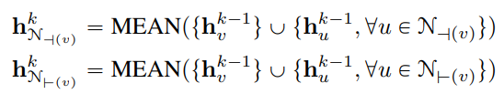
Static Dependency Graph Construction
Architecture
9
10
det
amod
12
17
X初始化节点向量
dep
compound
neigh
punct
16
14
13

Slide 15




Dynamic Graph Construction
Architecture
9
10
0.35
0.2
0.1
12
17
0.15
X初始化节点向量
0.1
16
0.1
14
13
$$\overline{A}=topk(A)$$

Slide 16



Dynamic Graph Construction
Architecture
9
10
0.35
0.2
0.1
12
17
0.15
X初始化节点向量
0.1
16
0.1
14
13

Slide 17
Graph2Seq
Architecture

Slide 18
LSTM Decoder
Architecture
copy mechanism
coverage mechanism

Slide 19
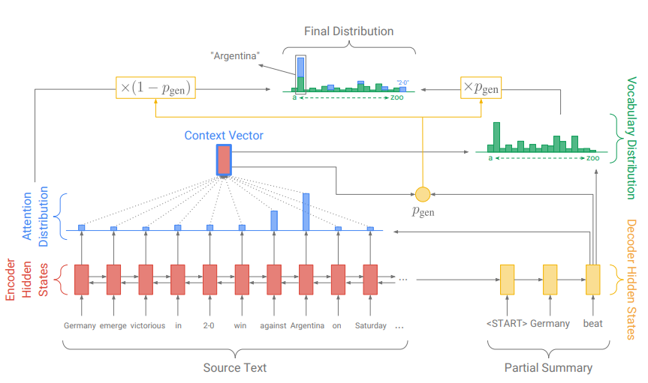
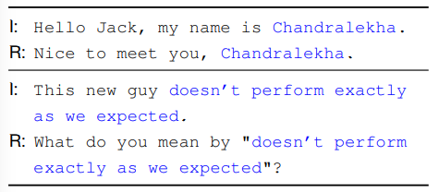
LSTM Decoder: Copy Mechanism
Architecture
“Get To The Point: Summarization with Pointer-Generator Networks”

Slide 20



LSTM Decoder: Coverage Mechanism
Architecture
“Get To The Point: Summarization with Pointer-Generator Networks”

Slide 21



Hybrid Evaluator
Architecture
self-critical sequence training (SCST) algorithm
$f_{eval}$:BLEU-4 $f_{sem}$:word movers distance

Slide 22
Results

Slide 23
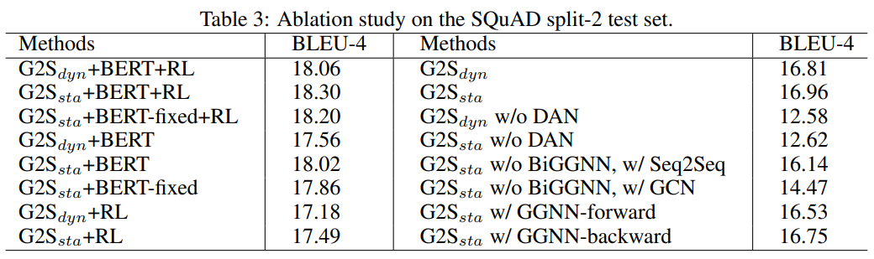
Ablation Study
Results

Slide 24
End

